Slide 1
Project title
Submitted in the partial fulfillment for the award of the degree of
BACHELOR OF ENGINEERING
IN
Games and Graphics
Submitted by:
Bishal Ganguly (20BCG1066)
Arnav Sahu (20BCG1011)
Under the Supervision of:
Mr. Sant Kumar Maurya
Department of AIT-CSE
DISCOVER . LEARN . EMPOWER

Slide 2
Outline
Introduction to Project
Problem Formulation
Objectives of the work
Methodology used
Results and Outputs
Conclusion
Future Scope
References

Slide 3
Introduction to Project
This project is a web based shopping system for an existing shop. The project objective is to deliver the online shopping application into cross platform.
Online shopping is the process whereby consumers directly buy goods or services from a seller in real-time, without an intermediary service, over the Internet. It is a form of electronic commerce.
This project is an attempt to provide the advantages of online shopping to customers of a real shop. It helps buying the products in the shop anywhere through internet by using an android device.
Thus the customer will get the service of online shopping and home delivery from his favorite shop

Slide 4
PROJECT SCOPE
This system can be implemented to any shop in the locality or to multinational branded shops having retail outlet chains. The system recommends a facility to accept the orders 24*7 and a home delivery system which can make customers happy.
If shops are providing an online portal where their customers can enjoy easy shopping from anywhere, the shops won’t be losing any more customers to the trending online shops such as flipcart or ebay. Since the application is available in the Smartphone it is easily accessible and always available.

Slide 5
Problem Formulation
E-commerce provides an easy way to sell products to a large customer base. However, there is a lot of competition among multiple e-commerce sites. When users land on an e-commerce site, they expect to find what they are looking for quickly and easily. Also, users are not sure about the brands or the actual products they want to purchase. They have a very broad idea about what they want to buy. Many customers nowadays search for their products on Google rather than visiting specific e-commerce sites. They believe that Google will take them to the e-commerce sites that have their product.
The purpose of any e-commerce website is to help customers narrow down their broad ideas and enable them to finalize the products

Slide 6
Objectives of the Work
The objective of the project is to make an application in Web Site platform to purchase items in an existing shop. In order to build such an application complete web support need to be provided. A complete and efficient web application which can provide the online shopping experience is the basic objective of the project. The web application can be implemented in the form of an android application with web view.

Slide 7
Methodology used
The five phases of the project are as follows:
Scoping and planning
This phase focuses on the planning of the project’s overall direction, including the definition of the project’s scope, objectives, and timelines. The deliverable from this phase is this Design Plan.
Conceptual design and research
In this phase, the conceptual design of the methodology is developed and research on existing methodologies is conducted. Research is performed from independent research firms, such as the Gartner Group, Forrester Research, and CIO.com

Slide 8
Development of methodology
The actual methodology is developed in this phase. Detailed descriptions of each task in the methodology are documented, including the objectives, inputs, approach, relevant models, applicable tools and techniques, outputs, and any references.
Implementation of methodology
The methodology will be implemented with a client. This phase includes the marketing of E-commerce strategy development services and the closing of the sale, followed by the actual implementation.
Revision of methodology
Final touches and revisions to the methodology are made in this phase. The majority of these revisions come from experiences on the client project. Sample reports and any additional references are added to the methodology.

Slide 9
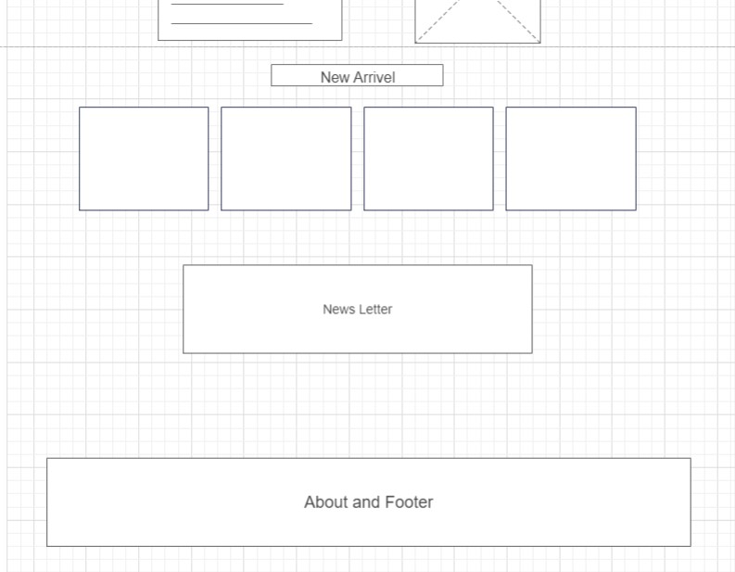
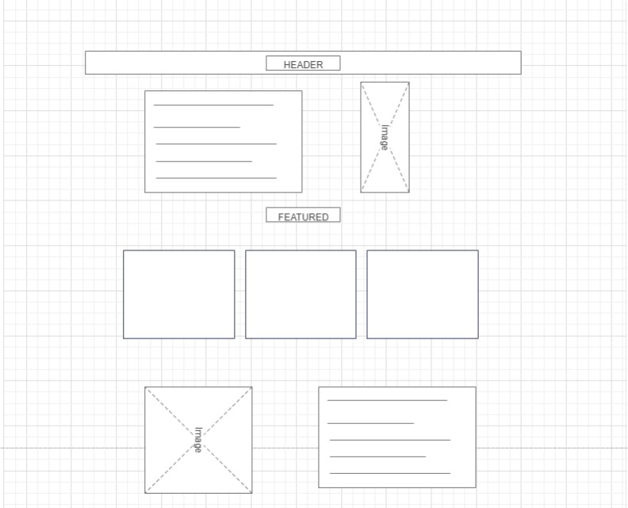
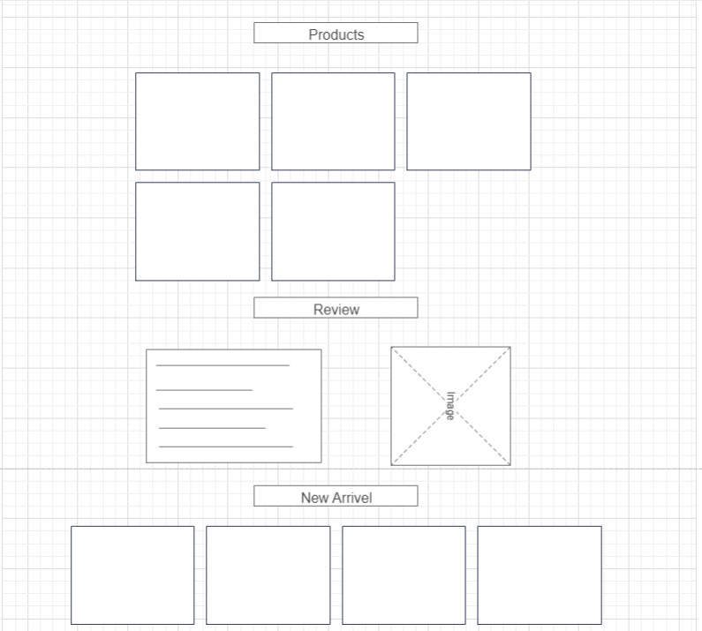
WIRE FRAME

Slide 10
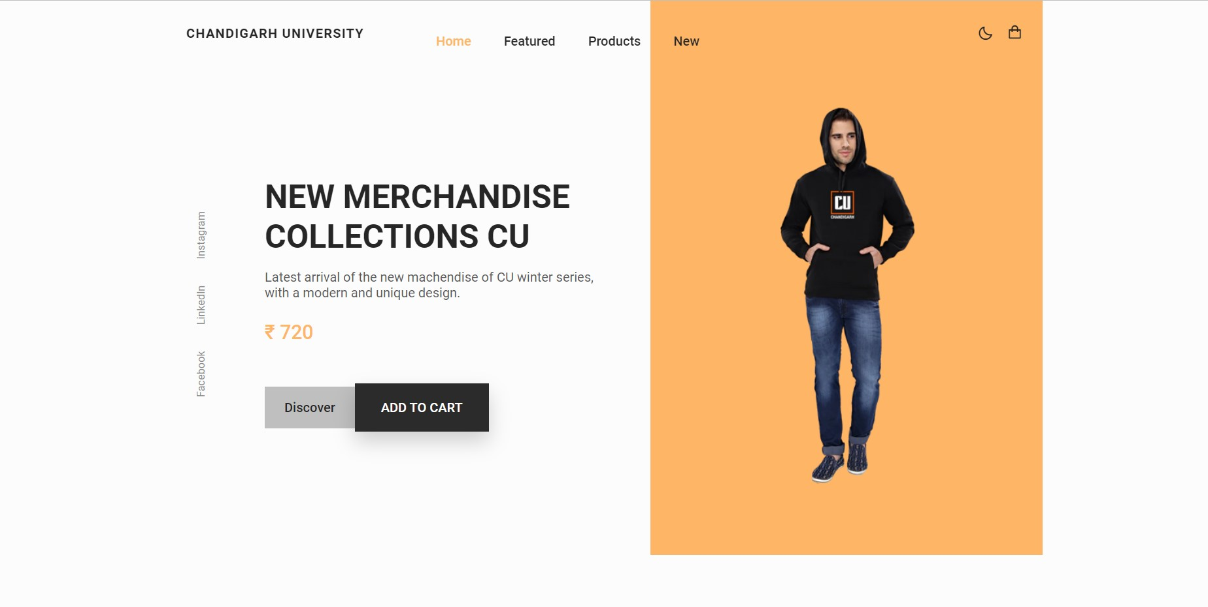
Results and Outputs
Preview

Slide 11
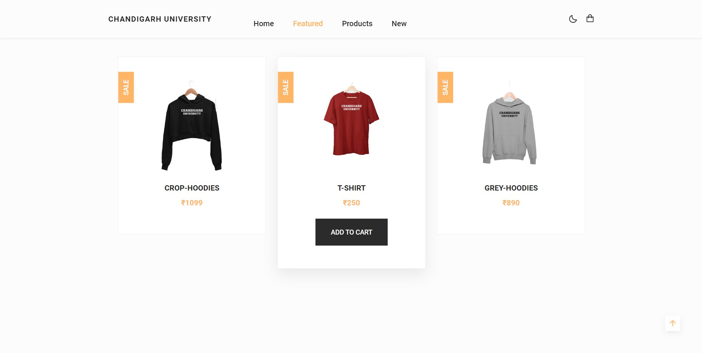
Featured Product

Slide 12
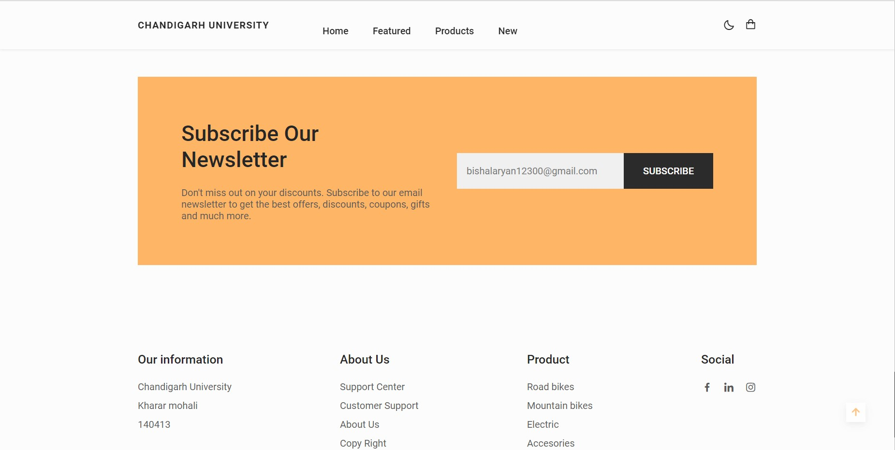
News Letter and Footer

Slide 13
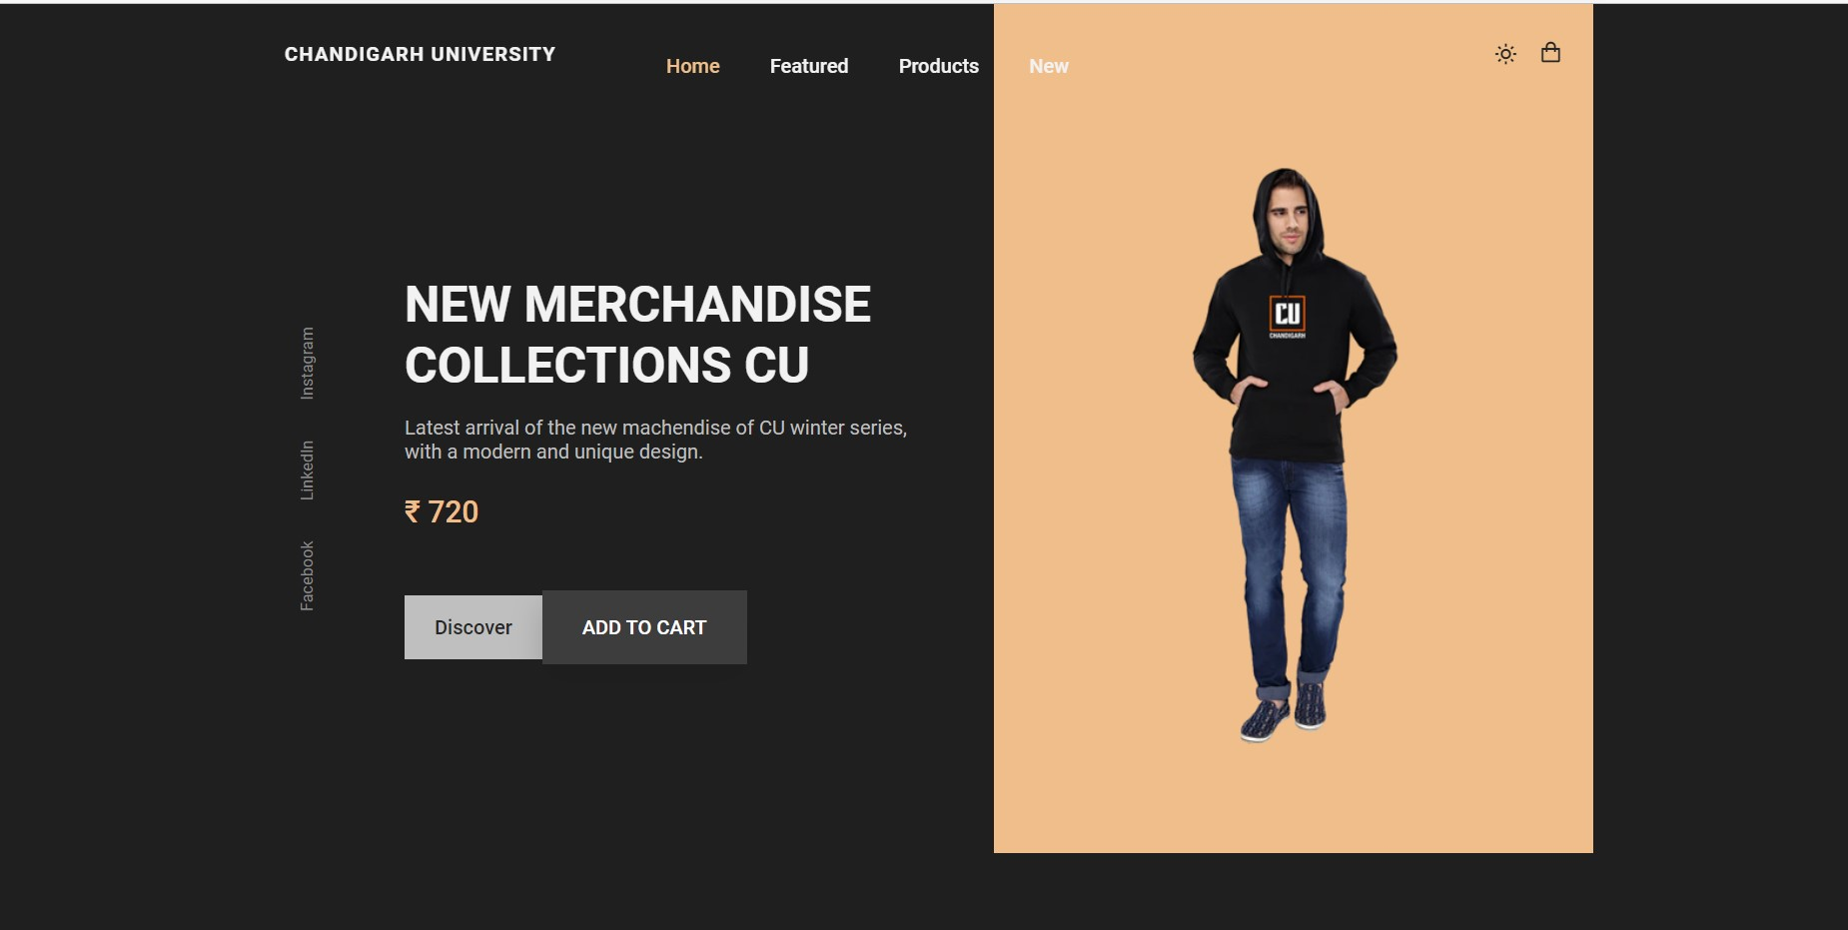
Dark Theme

Slide 14
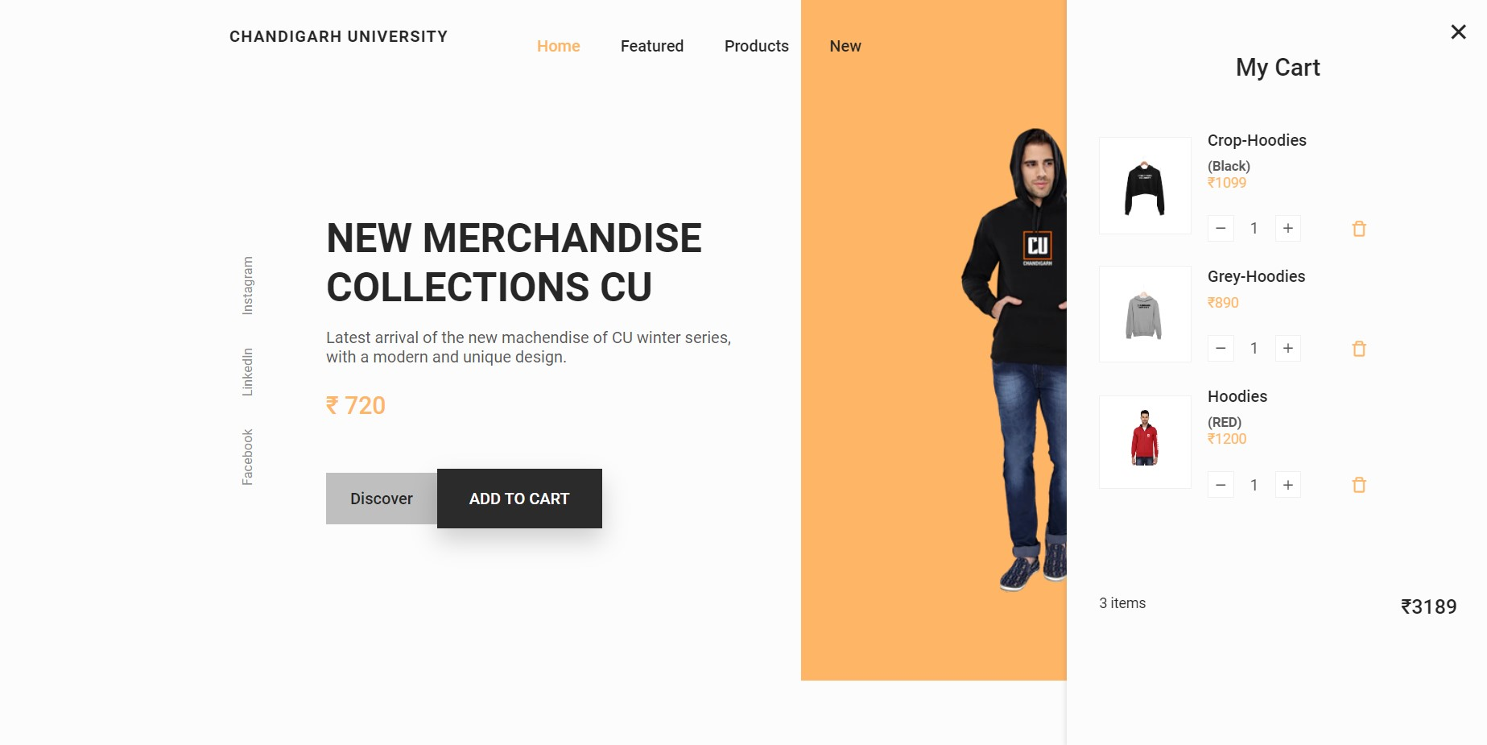
Cart View

Slide 15
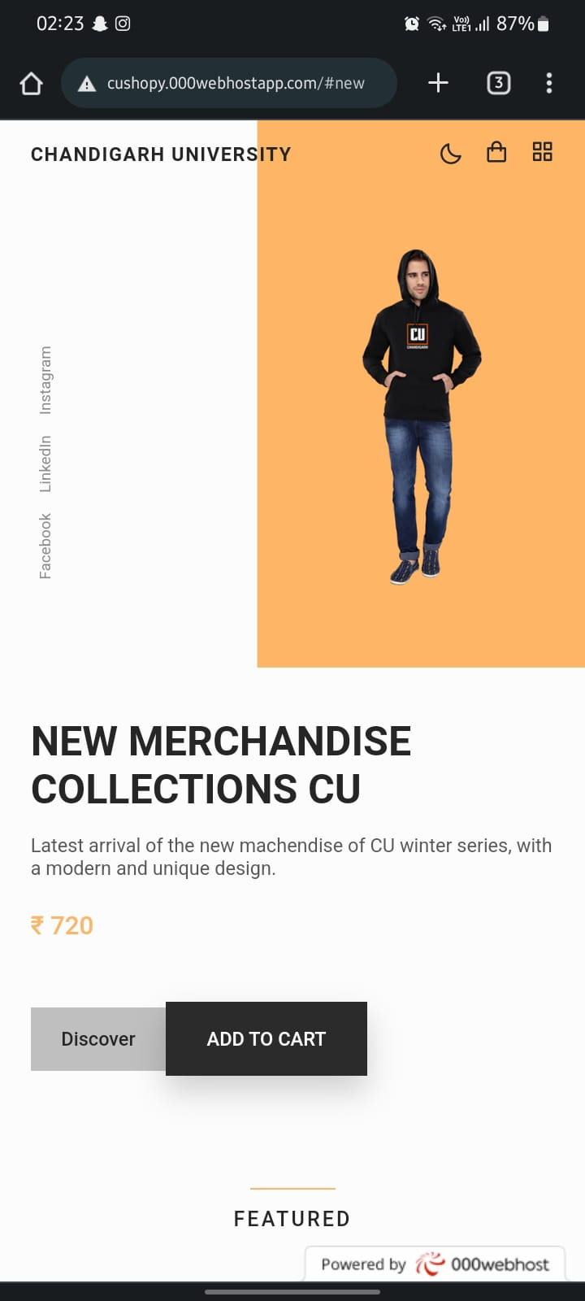
Responsive design

Slide 16
Conclusion
The project entitled E-Shopping Web Application was completed successfully. The system has been developed with much care and free of errors and at the same time it is efficient and less time consuming. The purpose of this project was to develop a web application and an android application for purchasing items from a shop. This project helped us in gaining valuable information and practical knowledge on several topics like designing web pages using html & css, usage of responsive templates, designing of android applications, and management of database using mysql .

Slide 17
Future Scope
E-Commerce has grown in importance because of all the advantages it offers to sellers and buyers. It is especially relevant in the current scenario of the Covid-19 pandemic when there are nationwide lockdowns.
Even traditional retailers hurriedly created online stores to maintain business continuity during the pandemic. This augurs well for the scope of e-commerce all over the world. Everything from groceries to sports equipment can now be bought online.
Globally, e-commerce sales increased by 77% over the previous year. In India alone, eCommerce is growing at about 51% annually.
E-Commerce enables manufacturers and traders from remote, rural places to sell their products online; their own local markets may be too small, and not have the kind of consumers the seller needs.

Slide 18
References
[1] JavaScript Enlightenment,Cody Lindley-First Edition, based on
JavaScript 1.5, ECMA-262, Edition
[2] Mc GrawHill’s , Java : The complete reference 7thEdition, Herbert
Schildit
[3] Complete CSS Guide ,Maxine Sherrin and John Allsopp-O'Reilly
Media; September 2012
• http://www.w3schools.com/html/defualt.asp,
• http://www.w3schools.com/css/default.asp,
• http://www.w3schools.com/js/default.asp

